Slide 1




oilQuad Measure engine oil viscosity for efficient tracking of engine health
Team Name: MobiTech
Varun Bhattacharya(Leader) – PhNo, Email
Ketan Agrawal – PhNo, Email
College: Vellore Institute of Technology, Vellore, India
Notes:
Greetings everyone!
Allow me to introduce our visionary team, Mobi Tech, and our groundbreaking solution designed to revolutionize the way we monitor and maintain vehicle engine health - the OIL QUAD.
I am Varun Bhattacharya, honored to serve as the leader of this dynamic team. Alongside me is the exceptionally talented Ketan Agrawal, a distinguished member of our team hailing from VIT Vellore India. Together, we are here to unveil a pioneering solution that not only addresses a significant business problem but also does so with a focus on cost-efficiency and unparalleled effectiveness.

Slide 2

What is oilQuad ?
oilQuad represents an innovative system featuring a bespoke viscometric device designed for the precise determination of optimal car oil change intervals. This intelligent system seamlessly transmits crucial data to a shared cloud infrastructure, enabling authorized individuals to access and analyze this information. Through informed insights on oil condition and performance trends, pertinent actions can be taken promptly, enhancing the overall maintenance and longevity of the vehicle.
Notes:
What is OIL QUAD ?
oilQuad represents an innovative system featuring a bespoke viscometric device designed for the precise determination of optimal car oil change intervals. This intelligent system seamlessly transmits crucial data to a shared cloud infrastructure, enabling authorized individuals to access and analyze this information. Through informed insights on oil condition and performance trends, pertinent actions can be taken promptly, enhancing the overall maintenance and longevity of the vehicle.

Slide 3

Deciphering the Business Conundrum
Frequently, the automotive industry relies on the conventional practice of adhering to fixed time intervals for car engine oil changes in the pursuit of performance enhancement.
However, this time-based approach, while deeply ingrained, reveals shortcomings in terms of efficiency, potential harm to the vehicle's performance, and an associated financial burden.
A pressing concern emerges from the fact that engine oil may not consistently demand replacement strictly according to predetermined intervals.
This inconsistency raises questions about whether an immediate oil change is necessary to uphold the vehicle's optimal performance levels, calling for a reevaluation of this conventional practice.
Notes:
What is the actual business problem being faced ?
Often it is assumed that after a fixed time intervals, the car engine oil has to be altered for better performance. This process of assuming the fixed time interval can be very inefficiant, hampers the car's performance and also expensive. The car engine oil sometimes may not be fit to use before the given time interval or even sometimes after the time interval. The main need for such an issue lies whether the oil has to be changed at that moment or not by maintaining the car's performance level.

Slide 4
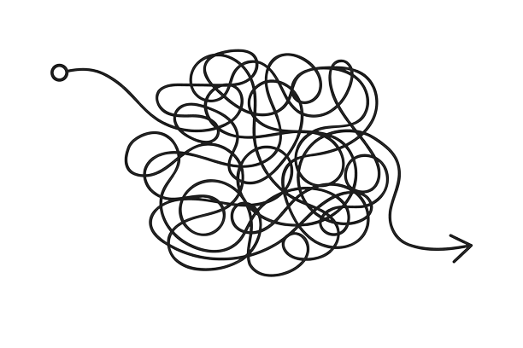
Avoiding the Issue: Potential Outcomes
Financial Burden: Neglecting an efficient oil change method can lead to unnecessary costs as frequent, unnecessary oil changes strain the budget of car owners.
Environmental Impact: Overuse and disposal of engine oil contribute to environmental pollution, harming ecosystems and public health.
Resource Wastage: Unnecessary oil changes result in the wastage of oil resources, which are finite and valuable.
Inefficient Maintenance: Inaccurate oil change intervals can lead to inefficient maintenance practices, impacting the overall performance and longevity of the vehicle.
Consumer Inconvenience: Frequent oil changes disrupt car owners' schedules and result in inconvenience, affecting their daily lives.
Notes:
What happens if we avoid such an issue? Will there be any problem created?
There can be various problems posed while avoiding this issue. Some of the potential problems which may expect can be Financial Burden, Environmental Impact, Resource Wastage, Inefficient Maintenance, and Consumer Inconvenience, thus there can be a business loss in the upcoming long run.

Slide 5

Key Stakeholders
Vehicle Owners: Owners play a central role as they are directly impacted by oil change decisions and need to maintain their vehicles efficiently.
Automotive Manufacturers: These manufacturers can influence oil change guidelines and contribute to developing technology for more precise interval determination.
Oil Producers: Oil companies play a crucial role in offering products that align with changing intervals and environmental standards.
Environmental Agencies: Environmental regulators ensure that oil change practices are environmentally responsible and adhere to guidelines.
Service Centers, Technology Developers, and Insurers: These entities provide the expertise, tools, and services needed to implement efficient oil change strategies and help vehicle owners make informed decisions.
Notes:
Who are the key stakeholders we are aiming for to resolve such an issue ?
The main stakeholders are the vehicle owners, automotive manufacturers, oil producers, environmental agencies and the service centers, technology developers and insurers.

Slide 6

Addressing the Challenge
The proposed plan entails the integration of Thermal Sensors within the engine oil tube to facilitate the continuous measurement of oil viscosity and temperature levels at regular intervals, enabling real-time monitoring and data analysis.
Utilizing Heat Transfer: Thermal Sensors are deployed to measure oil viscosity by employing the principles of heat transfer. These sensors apply heat to a specific element and gauge the rate of cooling as oil flows through it. The rate at which heat dissipates or is conducted away by the fluid provides a precise measure of viscosity.
Sensor Composition: The Thermal Sensor comprises a heating element and a temperature sensor, such as a thermistor or RTD. The heating element initiates the heating process, while the temperature sensor records the rate of cooling or temperature change, delivering a comprehensive assessment of oil viscosity.
Notes:
What is the solution we propose?
The plan is to incorporate the Thermal Sensors in the engine oil tube for measuring the oil viscosity as well as the temperature level of oil at regular intervals and monitoring it.
Thermal Sensors use the concept of heat transfer to measure viscosity. This sensor actually heats a particular element and then measures the cooling rate as the oil flow passes through it. The rate at which heat dissipates or is conducted away by the fluid will give us the viscosity value.
The thermal sensor consists of the heating element and the temperature sensor (i.e.. a thermistor or RTD). The heating element warms up, and the temperature sensor measures the rate of cooling or temperature change gives us the oil viscosity value.

Slide 7
Addressing the Challenge - II
Viscosity and Fluid Characteristics: Viscosity directly correlates with fluid characteristics. More viscous fluids exhibit slower heat conduction and temperature change compared to less viscous ones. Understanding viscosity is vital, as it impacts lubrication effectiveness, particularly in cold and hot engine conditions.
Effect of Temperature: Heating of the oil causes oxidation, which, in turn, influences the oil's viscosity. Temperature-induced viscosity changes can significantly impact engine performance.
Data Transmission and Analysis: The Thermal Sensors transmit data to the primary microprocessor integrated within the car's internal system. Subsequently, the microprocessor conveys the data to a shared cloud in a user-friendly format. This shared cloud serves as a repository for historical data, allowing for the assessment of engine oil viscosity against established ratings (e.g., 10W, 30) for both hot and cold conditions. Notifications are then generated for car owners and dealerships, enabling timely action to be taken in response to changing viscosity levels.
This comprehensive proposal outlines a sophisticated system for real-time oil viscosity monitoring, aimed at enhancing vehicle performance and maintenance efficiency.
Notes:
Viscous fluids will conduct heat more slowly, resulting in a slower temperature change compared to less viscous fluids. Higher the viscousity of the fluid, it appears more thicker and it becomes less effective at lubrication and can lead to poor enginer performance during cold condition and vice versa in hot condition.
As the oil gets heated, it becomes oxidized and viscosity changes due to that.
The sensors will then transmit the signal to the main microprocessor installed in the car internal system which will then transmit the data to the shared cloud in human readible format.
The data will be stored in the shared cloud and based on the car engine oil viscosity rating (given as 10W, 30 (for eg.) where 10cP and 30cSt is the rating for hot and cold conditions) and based on the history of oil viscosity, the car owner and the dealership will be notified on it for taking the necessary actions regarding it.

Slide 8
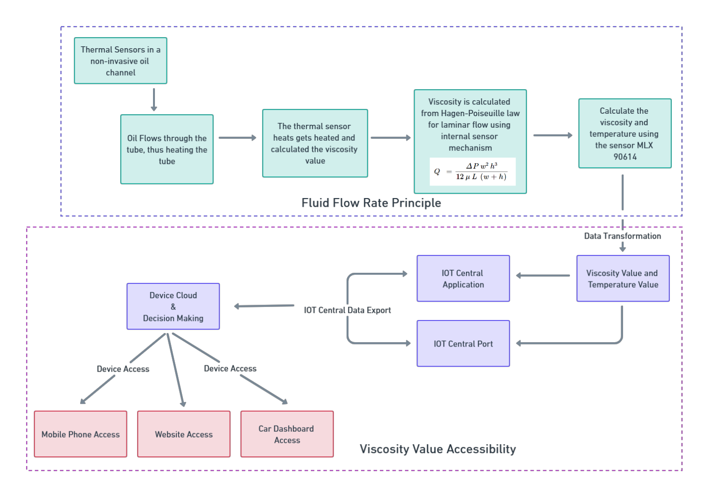
Architectural Framework of the Proposed Solution
Notes:
Here is an architechtural proposal for the above mentioned solution.
The viscosity sensors will be put on the body of engine oil tube using non-invasive methods for measuring the oil viscosity.
As the oil flows through the tube, an element in the sensor is heated upto a certain level. When the oil passed by, the rate at which it flows through the hot area of the sensor will determine the oil viscosity. The sensor uses the Hagen-Poiseuille law for calculating the viscosity of oil internally.
For measuring the oil temperature, we can measure using the same sensor mentioned above and also we can try using the infrared sensor MLX90614 for the same.
The signals are then passed on to the main microprocessor in the internal car system where the byte values are converted into human readible format. From the microprocessor, the values are then passed onto the main shared cloud which is the IOT Central Application using the ports and transferred into the main upstream cloud platform. From the cloud, the historical data is already stored for every single values of the sensor readings and based on the incoming data as well as the historical data, decision is made by the platform which can be accessible to the stakeholders using mobile phones, website and the car dashboard for effective management purposes.

Slide 9

System Setup Procedure
Installation of a viscosity sensor within or external to the car engine oil tube through non-invasive techniques to facilitate the measurement of oil viscosity and temperature.
Acquisition of signals from these sensors and their transmission to a dedicated microprocessor.
Integration of the microprocessor within the vehicle's internal system to facilitate the transmission of collected data to a shared cloud platform.
Establishment of a shared cloud infrastructure for data storage and accessibility.
Data retention in the shared cloud, with notifications provided to both the car owner and dealership based on the car engine oil viscosity rating (e.g., 10W, 30), which includes values for both hot and cold conditions. Notifications are triggered based on the historical trends in oil viscosity, prompting necessary actions as warranted.
Notes:
The system setup procedure is mentioned over here.
We install the viscosity sensor external to the car oil tube using non-invasive techniques to facilitate the measurement of oil viscosity and temperature.
The signals are acquired through the main microprocessor of the car internal system and their then that data is passed on to the shared cloud platform to the central application via the central ports.
The cloud infrastructure has to be established for the seamless data storage and accessibility purpose.
The data will be then analysed through the actual oil viscosity rating of that specific car and then based on the other historical data from the sensors any decision will be made by itself for further analysis.

Slide 10
Thank You
Notes:
Thank You for hearing us with patience. We hope that this solution can help us resolve such an issue and help the car companies focus on their performance and effectiveness purpose.

